Slide 1
Kidney diseases Introduction
Emad Abokhabar
Lecturer of internal medicine and nephrology
Sohag University

Slide 2
ANATOMY & PHYSIOLOGY OF KIDNEY & KIDNEY DISORDERS

Slide 3
The kidneys: An Excretory organ or a Regulatory organ?!!!

Slide 4
The Kidneys- function
The main purpose of the kidney is to separate urea, mineral salts, toxins, and other waste products from the blood.
They also do the job of conserving water, salts, and electrolytes.
At least one kidney must function properly for life to be maintained.

Slide 5
The Human Kidney
bean shaped, reddish brown organs.
about the size of your fist.
It measures 10-12 cm long.
covered by a tough capsule of fibrous connective tissue- renal capsule
Adhering to the surface of each kidney-two layers of fat to help cushion them.

Slide 6
The Human Kidneys
concaved side having a depression where a renal artery enters, and a renal vein and a ureter exit the kidney.
located in the upper rear region of the abdominal cavity just above the waistline.
protected by the ribcage.
The renal cortex, the renal medulla and the renal pelvis - major regions of the kidney.
The left kidney lies slightly above the right kidney.

Slide 7
The Kidney Diagram

Slide 8
Kidneys and their structures
The Renal Arteries
transport oxygenated blood from the heart and aorta to kidneys for filtration
The Renal Veins
Transport the filtered, deoxygenated blood from kidneys to the posterior vena cava and finally the heart

Slide 9
Kidneys and their structures
Renal Capsule (inferior/superior)
Outer membrane which encloses and protects kidneys against infections and trauma.
The Renal Cortex
Outer layer (granulated) of the kidney that contains most of the nephrons.

Slide 10
Kidneys and their structures
Nephron
Most basic microscopic structures of the kidneys
Inside each kidney, there are about 1 million nephrons
Physiological unit of the kidney used for filtration of blood, and reabsorption and secretion of materials

Slide 11
Kidneys and their structures
The Renal Medulla
Inner layer (radially striated) of the kidney
contains renal pyramids, renal papillae, renal columns, renal calyces (minor/major),renal pelvis and part of nephron, not located in the cortex
Site for salt, water and urea absorption

Slide 12
Kidneys and their structures
The Renal Pyramid
Triangular shaped unit in the medulla
houses the loop of Henle and collecting duct of the nephron
The Renal Column
Area between the pyramids, located in the medulla
Used as a space for blood vessels

Slide 13
Kidneys and their structures
The Renal Papillae
The tips of the renal pyramids
release urine into the calyces
The Renal Calyces
Collecting sacs that surround the renal papillae
Transport urine from renal papillae to renal pelvis

Slide 14
Kidneys and their structure
The Renal Pelvis
Cavity which lies in the centre of the kidney and which extends into the ureter
Collects urine from all of the calyces in the kidney

Slide 15
Kidneys and their structures
The Ureters (right/left)
Tubes that transports urine from the renal pelvis to the bladder
The Urinary Bladder
Hollow, expandable, muscular organ located in the pelvic girdle
Functions as a temporary reservoir for urine

Slide 16
The Kidney Nephron Diagram

Slide 17
The two types of Nephrons
Cortical
The loop of Henle does not extend past the cortex of the kidney.
Juxtamedullary
Loop of Henle extends past the cortex and into the medulla of the kidney.

Slide 18
Nephron structures and functions
Afferent Arteriole
Transport arterial blood to glomerulus for filtration
Efferent Arteriole
Transports filtered blood from glomerulus through the peritubular capillaries and the vasa recta, and to the kidney venous system

Slide 19
Nephron structures and functions
Glomerulus
The site for blood filtration
operates as a nonspecific filter - removes both useful and non-useful material
the product of the glomerulus – filtrate
Bowman’s Capsule
A sac that encloses glomerulus
transfers filtrate from the glomerulus to the Proximal Convoluted Tubule (PCT)

Slide 20
Nephron structures and functions
Proximal Convoluted Tubule (PCT)
A thick, constantly active segment of the nephron
that reabsorbs most of the useful substances of the filtrate: sodium (65%), water (65%), bicarbonate (90%), chloride (50%), glucose (nearly 100%)
The primary site for secretion (elimination) of drugs, waste and hydrogen ions.

Slide 21
Nephron structures and functions
The loop of Henle
U-shaped tube that consists of a descending limb and an ascending limb.
begins in the cortex, receiving filtrate from the PCT, extends into the medulla, and then returns to the cortex to empty into the distal convoluted tubule(DCT).
Its primary role is to concentrate the salt in the interstitium, the tissue surrounding the loop.

Slide 22
Nephron structures and functions
Decending Limb of the Loop of Henle
A part of the counter current multiplier
fully permeable to water and completely impermeable to solutes (salt particles)
receives filtrate from the PCT, allows water to be absorbed and passes “salty” filtrate to the next segment.
“Saves water and passes the salt”

Slide 23
Nephron structures and functions
Ascending Limb of the loop of Henle
a part of the counter current multiplier
impermeable to water and actively transports (reabsorbs) salt (NaCl) to the interstitial fluid of the pyramids in the medulla.
“Saves salt and passes the water.”
the passing filtrate becomes dilute and the interstitium becomes hyperosmotic

Slide 24
Nephron structures and functions
Distal Convoluted Tubule (DCT)
Variably active portion of the nephron
receives dilute fluid from the ascending limb of the loop of Henle

Slide 25
Nephron structures and functions
Collecting Duct
variably active portion of the Nephron
receives fluid from the DCT
The last segment to save water for the body

Slide 26
Nephron structures and functions
Peritubular Capillaries
transport reabsorbed materials from the PCT and DCT into kidney veins and eventually back into the general circulation
help complete the conservation process (reabsorption) that takes place in the kidney

Slide 27
1. Filtration of Blood The glomerulus is the site of filtration of blood.

Slide 28
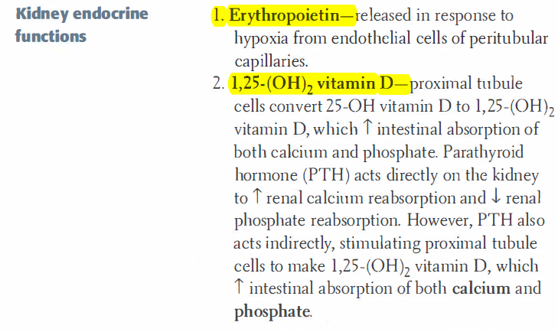
Physiology

Slide 29
Physiology endocrine functions

Slide 30
The Bowman’s capsule (basement membrane + podocytes)
filters blood,
hold back large molecules such as proteins,
passes through small molecules such as water, salts, and sugar
Aids in the formation of urine

Slide 31
PODOCYTES:
Also known as visceral epithelial cells
Cells in the Bowman's capsule in the kidneys that wrap around the capillaries of the glomerulus leaving slits between them.
They are involved in regulation of glomerular filtration rate (GFR). When podocytes contract, they cause closure of filtration slits. This decreases the GFR by reducing the surface area available for filtration.

Slide 32
The Juxtaglomerular Apparatus

Slide 33
Physiology

Slide 34
Formation of urine
Takes place in 3 main steps;
Ultrafiltration
seeping of fluid from glomerular capillaries to the Bowman’s capsule along with useful substances (e.g. glucose, vitamins ,amino acids)
2. Reabsorption along the nephron
PCT; selective reabsorption of useful substances
LOH, DCT and CD Reabsorption of water and salts
3. Secretion from blood to tubule

Slide 35
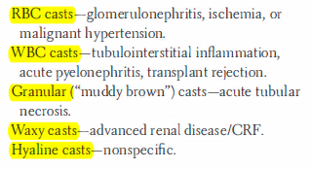
Casts in urine

Slide 36
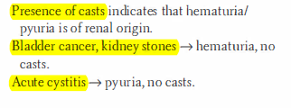
N.P

Slide 37
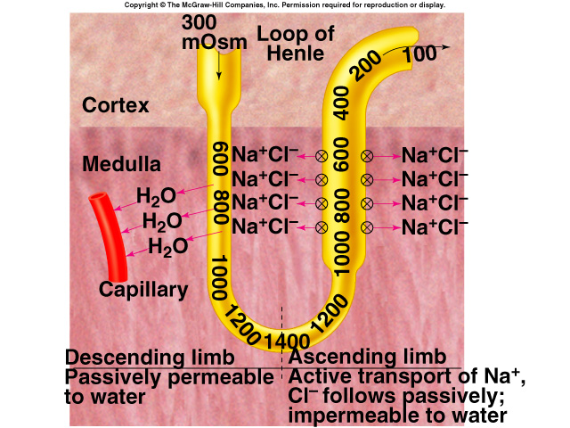
Counter Current Multiplier
A system of limbs
running in opposite
directions
Consists of;
Descending limb and
Ascending limb of the
Loop of Henle.
Helps in the absorption
of water from fluid
found in the LOH

Slide 38
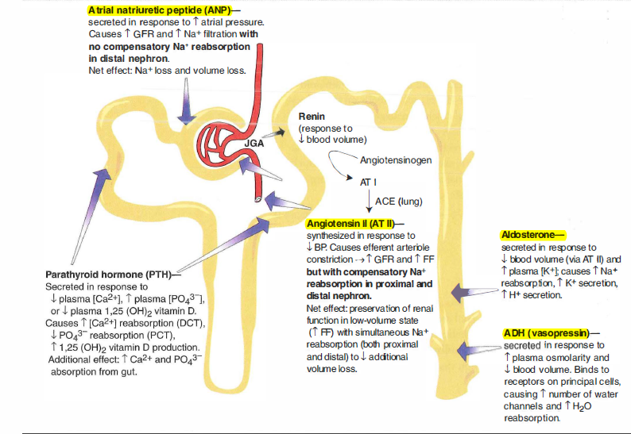
Hormons acting on the kidney

Slide 39
RENAL PATHOLOGY

Slide 40
Kidney disorders
Are diseases that affect the kidney.
Usually affects both kidneys.
The kidneys ability to remove waste products and control water balance is severely affected.
This causes an accumulation of waste products and fluids causing severe uremia.
Uremia=kidney failure

Slide 41
Signs of kidney problems!!!
proteins, blood or glucose in urine
The GFR is usually assessed to confirm kidney disease; determine amount of inulin excreted.
A fall in GFR= kidney disease is obvious

Slide 42
Pathology
Nephrotic syndrome(Non-inflammatory)
Loss of podocyte structure
Large proteins can enter the renal corpuscle
Increase in urinary protein secretion=proteinuria

Slide 43
Acide-Base physiology

Slide 44
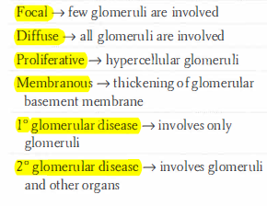
Name:

Slide 45
I am happy that now you know more about me!!!

Slide 46
Questions?

